Slide 1
CSS
Designing the world !

Slide 2
What is CSS
CSS stands for Cascading Style Sheets
CSS describes how HTML elements are to be displayed on screen, paper, or in other media

Slide 3
Lecture content
Linking to the document
CSS syntax
Backgrounds
Borders
Text
Box model
Positioning

Slide 4
Part 1: Linking

Slide 5
Linking HTML and CSS
HTML (content) and CSS (presentation) can be linked in three ways:
Inline: the CSS rules in the style attribute
No selectors are needed
Internal: in the <head> in a <style> tag
External: CSS rules in separate file (best)
Usually a file with .css extension
Linked via <link rel="stylesheet" href=…> tag or @import directive in embedded CSS block

Slide 6
Linking HTML and CSS (2)
Using external files is highly recommended
Simplifies the HTML document
Improves page load speed as the CSS file is cached

Slide 7
CSS Cascade (Precedence)
There are browser, user and author stylesheets with "normal" and "important" declarations
Browser styles (least priority)
Normal user styles
Normal author styles (external, in head, inline)
Important author styles
Important user styles (max priority)
a { color: red !important ; }

Slide 8
Part 2: Syntax

Slide 9
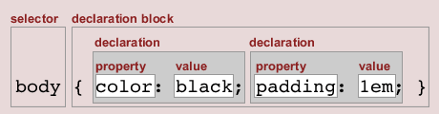
Style Sheets Syntax
Stylesheets consist of rules, selectors, declarations, properties and values
Selectors are separated by commas
Declarations are separated by semicolons
Properties and values are separated by colons
h1,h2,h3 { color: green; font-weight: bold; }

Slide 10
Selectors
Selectors determine which element the rule applies to:
All elements of specific type (tag)
Those that mach a specific attribute (id, class)
Elements may be matched depending on how they are nested in the document tree (HTML)
Examples:
.header a { color: green }
#menu>li { padding-top: 8px }

Slide 11
Selectors (2)
Three primary kinds of selectors:
By tag (type selector):
By element id:
By element class name (only for HTML):
Selectors can be combined with commas:
This will match <h1> tags, elements with class link, and element with id top-link
h1 { font-family: verdana,sans-serif; }
#element_id { color: #ff0000; }
.myClass {border: 1px solid red}
h1, .link, #top-link {font-weight: bold}

Slide 12
Selectors (3)
Pseudo-classes define state
:hover, :visited, :active , :lang
Pseudo-elements define element "parts" or are used to generate content
:first-line , :before, :after
a:hover { color: red; }
p:first-line { text-transform: uppercase; }
.title:before { content: "»"; }
.title:after { content: "«"; }

Slide 13
Selectors (4)
Match relative to element placement:
This will match all <a> tags that are inside of <p>
* – universal selector (avoid or use with care!):
This will match all descendants of <p> element
+ selector – used to match “next sibling”:
This will match all siblings with class link that appear immediately after <img> tag
p a {text-decoration: underline}
* {color: black}
p * {color: black}
img + .link {float:right}

Slide 14
Selectors (5)
> selector – matches direct child nodes:
This will match all elements with class error, direct children of <p> tag
[ ] – matches tag attributes by regular expression:
This will match all <img> tags with alt attribute containing the word logo
.class1.class2 (no space) - matches elements with both (all) classes applied at the same time
p > .error {font-size: 8px}
input[type=text] {border: none}

Slide 15
Values in the CSS Rules
Colors are set in RGB format (decimal or hex):
Example: #a0a6aa = rgb(160, 166, 170)
Predefined color aliases exist: black, blue, etc.
Numeric values are specified in:
Pixels, ems, e.g. 12px , 1.4em
Points, inches, centimeters, millimeters
E.g. 10pt , 1in, 1cm, 1mm
Percentages, e.g. 50%
Percentage of what?...
Zero can be used with no unit: border: 0;

Slide 16
Part 3: Backgrounds

Slide 17
Backgrounds
image to be used as background, e.g.:
Using color background-color
Additionaly :
background-repeat
repeat-x, repeat-y, repeat, no-repeat
background-attachment
fixed / scroll
background-image:url("back.gif");

Slide 18
Backgrounds (2)
background-position: specifies vertical and horizontal position of the background image
Vertical position: top, center, bottom
Horizontal position: left, center, right
Both can be specified in percentage or other numerical values
Examples:
background-position: top left;
background-position: -5px 50%;

Slide 19
Background Shorthand Property
background: shorthand rule for setting background properties at the same time:
is equal to writing:
Some browsers will not apply BOTH color and image for background if using shorthand rule
background: #FFF0C0 url("back.gif") no-repeat fixed top;
background-color: #FFF0C0;
background-image: url("back.gif");
background-repeat: no-repeat;
background-attachment: fixed;
background-position: top;

Slide 20
Background-image or <img>?
Background images allow you to save many image tags from the HTML
Leads to less code
More content-oriented approach
<img> allows for more CSS control because it can be used as a selector with all the possible declarations

Slide 21
Backgrounds (3): CSS3 Background Size
The CSS3 background-size property allows you to specify the size of background images.
Values may be contain, cover or numerical value

Slide 22
Part 4: Borders

Slide 23
Borders
border-width: thin, medium, thick or numerical value (e.g. 10px)
border-color: color alias or RGB value
border-style: none, hidden, dotted, dashed, solid, double, groove, ridge, inset, outset
Each property can be defined separately for left, top, bottom and right
border-top-style, border-left-color, …

Slide 24
Border Shorthand Property
border: shorthand rule for setting border properties at once:
is equal to writing:
Specify different borders for the sides via shorthand rules: border-top, border-left, border-right, border-bottom
When to avoid border:0
border: 1px solid red
border-width:1px;
border-color:red;
border-style:solid;

Slide 25
Part 5: Text

Slide 26
Text-related CSS Properties
color – specifies the color of the text
font-size – size of font: xx-small, x-small, small, medium, large, x-large, xx-large, smaller, larger or numeric value
font-family – comma separated font names
Example: verdana, sans-serif, etc.
The browser loads the first one that is available
There should always be at least one generic font
font-weight can be normal, bold, bolder, lighter or a number in range [100 … 900]

Slide 27
CSS Rules for Fonts (2)
font-style – styles the font
Values: normal, italic, oblique
text-decoration – decorates the text
Values: none, underline, line-through, overline, blink
text-align – defines the alignment of text or other content
Values: left, right, center, justify

Slide 28
Shorthand Font Property
font
Shorthand rule for setting multiple font properties at the same time
is equal to writing this:
font:italic normal bold 12px/16px verdana
font-style: italic;
font-variant: normal;
font-weight: bold;
font-size: 12px;
line-height: 16px;
font-family: verdana;

Slide 29
Inline Styles: Example
<html>
<head>
<title>Inline Styles</title>
</head>
<body>
<p>Here is some text</p>
<p style="font-size:20pt">Here is some
more text</p>
<p style="font-size: 20pt;color:
#0000FF" >Even more text</p>
</body>
</html>

Slide 30
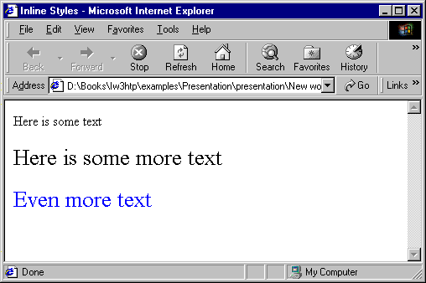

Slide 31
External Styles: Example
styles.css
/* CSS Document */
a { text-decoration: none }
a:hover { text-decoration: underline;
color: red;
background-color: #CCFFCC }
li em { color: red;
font-weight: bold }
ul { margin-left: 2cm }
ul ul { text-decoration: underline;
margin-left: .5cm }

Slide 32
External Styles: Example (2)
<html>
<head>
<title>Importing style sheets</title>
<link type="text/css" rel="stylesheet"
href="styles.css" />
</head>
<body>
<h1>Shopping list for <em>Monday</em>:</h1>
<li>Milk</li>
…

Slide 33
External Styles: Example (3)
…
<li>Bread
<ul>
<li>White bread</li>
<li>Rye bread</li>
<li>Whole wheat bread</li>
</ul>
</li>
<li>Rice</li>
<li>Potatoes</li>
<li>Pizza <em>with mushrooms</em></li>
</ul>
<a href="http://food.com" title="grocery
store">Go to the Grocery store</a>
</body>
</html>

Slide 34
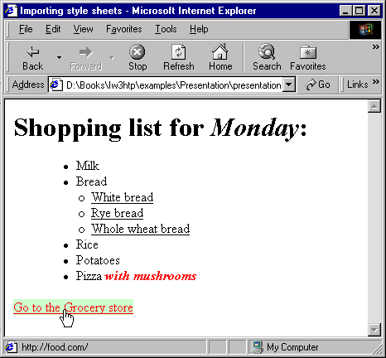

Slide 35
Part 6: box model

Slide 36
Width and Height
width – defines numerical value for the width of element, e.g. 200px
height – defines numerical value for the height of element, e.g. 100px
By default the height of an element is defined by its content
Inline elements do not apply height, unless you change their display style.

Slide 37
Margin and Padding
margin and padding define the spacing around the element
Numerical value, e.g. 10px or -5px
Can be defined for each of the four sides separately - margin-top, padding-left, …
margin is the spacing outside of the border
padding is the spacing between the border and the content
What are collapsing margins?

Slide 38
Margin and Padding: Short Rules
margin: 5px;
Sets all four sides to have margin of 5 px;
margin: 10px 20px;
top and bottom to 10px, left and right to 20px;
margin: 5px 3px 8px;
top 5px, left/right 3px, bottom 8px
margin: 1px 3px 5px 7px;
top, right, bottom, left (clockwise from top)
Same for padding

Slide 39
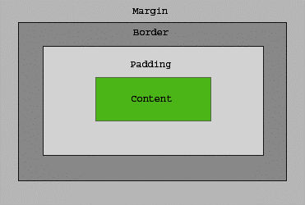
The Box Model

Slide 40
Default Browser Styles
Browsers have default CSS styles
Used when there is no CSS information or any other style information in the document
Caution: default styles differ in browsers
E.g. margins, paddings and font sizes differ most often and usually developers reset them
* { margin: 0; padding: 0; }
body, h1, p, ul, li { margin: 0; padding: 0; }

Slide 41
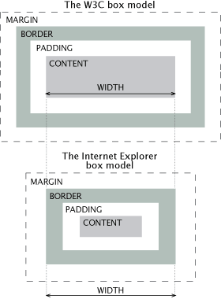
IE Quirks Mode
When using quirks mode (pages with no DOCTYPE or with a HTML 4 Transitional DOCTYPE), Internet Explorer violates the box model standard

Slide 42
Positioning
position: defines the positioning of the element in the page content flow
The value is one of:
static (default)
relative – relative position according to where the element would appear with static position
absolute – position according to the innermost positioned parent element
fixed – same as absolute, but ignores page scrolling

Slide 43
Positioning (2)
Margin VS relative positioning
Fixed and absolutely positioned elements do not influence the page normal flow and usually stay on top of other elements
Their position and size is ignored when calculating the size of parent element or position of surrounding elements
Overlaid according to their z-index
Inline fixed or absolutely positioned elements can apply height like block-level elements

Slide 44
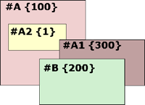
Positioning (3)
top, left, bottom, right: specifies offset of absolute/fixed positioned element as numerical values
z-index : specifies the stack level of positioned elements
Understanding stacking context
Each positioned element creates a stacking context.
Elements in different stacking contexts are overlapped according to the stacking order of their containers. For example, there is no way for #A1 and #A2 (children of #A) to be placed over #B without increasing the z-index of #A.

Slide 45
Inline element positioning
vertical-align: sets the vertical-alignment of an inline element, according to the line height
Values: baseline, sub, super, top, text-top, middle, bottom, text-bottom or numeric
Also used for content of table cells (which apply middle alignment by default)

Slide 46
Float
float: the element “floats” to one side
left: places the element on the left and following content on the right
right: places the element on the right and following content on the left
floated elements should come before the content that will wrap around them in the code
margins of floated elements do not collapse
floated inline elements can apply height

Slide 47
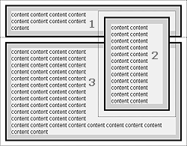
Float (2)
How floated elements are positioned

Slide 48
Clear
clear
Sets the sides of the element where other floating elements are NOT allowed
Used to "drop" elements below floated ones or expand a container, which contains only floated children
Possible values: left, right, both
Clearing floats
additional element (<div>) with a clear style

Slide 49
Clear (2)
Clearing floats (continued)
:after { content: ""; display: block; clear: both; height: 0; }
Triggering hasLayout in IE expands a container of floated elements
display: inline-block;
zoom: 1;

Slide 50
Opacity
opacity: specifies the opacity of the element
Floating point number from 0 to 1
For old Mozilla browsers use –moz-opacity
For IE use filter:alpha(opacity=value) where value is from 0 to 100; also, "binary and script behaviors" must be enabled and hasLayout must be triggered, e.g. with zoom:1

Slide 51
Visibility
visibility
Determines whether the element is visible
hidden: element is not rendered, but still occupies place on the page (similar to opacity:0)
visible: element is rendered normally

Slide 52
Display
display: controls the display of the element and the way it is rendered and if breaks should be placed before and after the element
inline: no breaks are placed before and after (<span> is an inline element)
block: breaks are placed before AND after the element (<div> is a block element)

Slide 53
Display (2)
none: element is hidden and its dimensions are not used to calculate the surrounding elements rendering (differs from visibility: hidden!)
There are some more possible values, but not all browsers support them

